Slide 1
Kalaiselvan M
RegNO:422521205016
Email Id:yaskalai1602@gmail.com
Shakespearean-Style Writer

Slide 2
PROJECT TITLE
Shakespearean-Style Writer using AutoRegressive (LSTM) Model

Slide 3
AGENDA:
Problem Statement
Project Overview
Who are the end users?
Your Solution and its value preposition
The wow in the Solution
Modelling
Result

Slide 4
PROBLEM STATEMENT
Nowadays creating new content is challenging as a writer and also difficult to resemble and follow writing styles of other late famous poets.
To overcome this problem we develop an AI-based system capable of generating text that mimics the writing style of William Shakespeare,with a specific focus on his renowned work “Hamlet”.
The primary objective is to create a tool using Autoregressive neural network that can produce new passages of text that could seamlessly integrate into the context of Shakespeare's works.

Slide 5
PROJECT OVERVIEW
This project implements the text generation model using autoregressive model such as LSTM neural network trained on Shakespeare’s “Hamlet” text.
The system should be able to take a given seed text as input and generate additional text that closely resembles Shakespearean language, syntax, and themes.
Thus by generating new content in the writing style of Shakespeare and closely resembles his works.

Slide 6
WHO ARE THE END USERS ?
Writers and Authors
Content Creators
AI enthusiasts and Researchers
Literature enthusiasts
Entertainment Industry
Students and Scholars
Educators

Slide 7
YOUR SOLUTION AND ITS VALUE PROPOSITION
The solution to the problem involves building a text generation model trained on Shakespearean’s works,to generate new text in the style of Shakespearean style.
The model utilizes LSTM neural networks to learn the patterns and nuances of shakespeare’s language and then generate coherent text that emulates his distinctive style.
VALUE PROPOSITION
Preservation of literary Heritage
Educational Tool
Creative Inspirations
Entertainment and Cultural Heritage

Slide 8
THE WOW IN THE SOLUTION
Authenticity:Generates text that is truly immersive experience reminiscent of reading Shakespeare’s original work
Creativity :Users are wowed by the endless possibilities for creative exploration that the model offers.
Versatility :The versatility of the project impress users with its wide range of application across various domains like from education to entertainment,to research to creativity.
Technological :Project showcases the technological innovation in natural Innovation language processing and Deep learning.

Slide 9
MODELLING
LIBRARIES USED :
TensorFlow
Numpy
NLTK(Natural Language Toolkit)
Keras
NEURAL NETWORK COMPONENT:
LSTM(Long Short-Term Memory)
Embedding Layer
Dense Layer

Slide 10
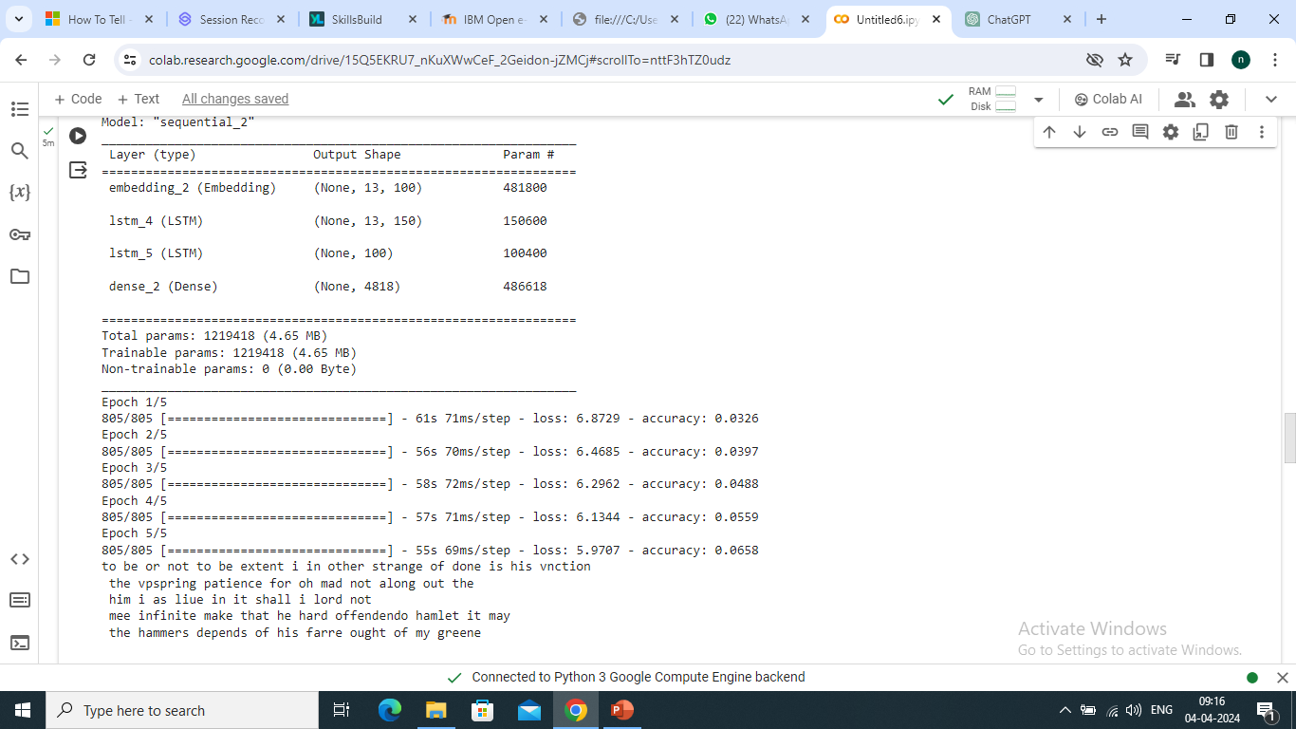
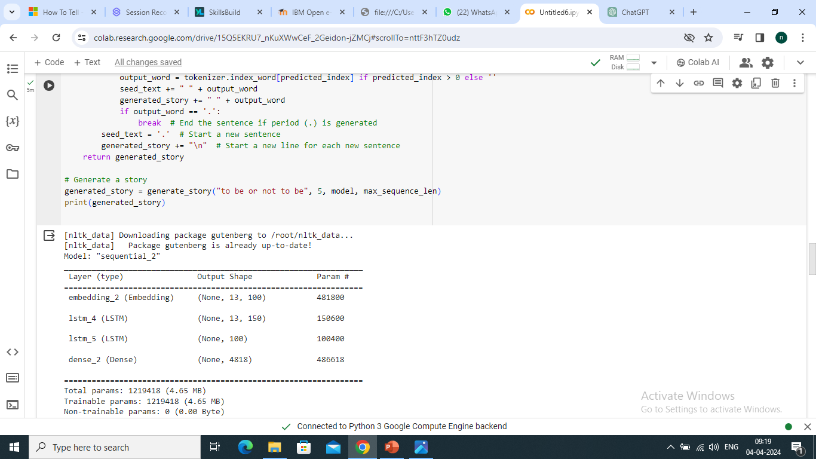
RESULT

Slide 11
CONCLUSION
Our project Successfully demonstrates the use of LSTM neural networks to generate text in the style of Shakespeare’s writing. Further improvements could be made through fine-tuning model architecture and hyperparameters or training on additional data.

Slide 12
THANK YOU !!!!

